Slide 1
Virtualization and Cloud Computing Final Project
Francesco Stucci – Federico Vivaldi

Slide 2
Project
Multi-tier application deployed with Docker Swarm
Components:
CRM
Database
Database administration tool
Reverse proxy service
Application monitor

Slide 3
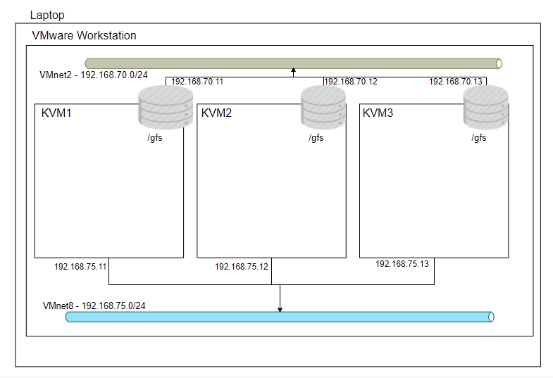
System architecture

Slide 4
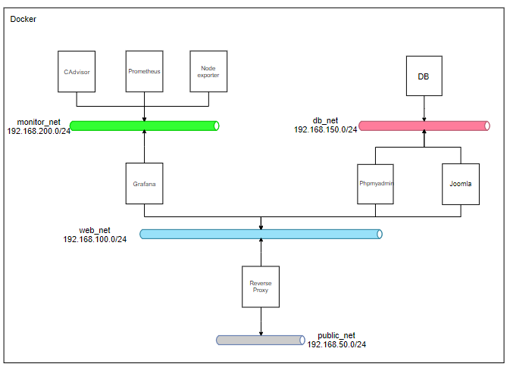
Container architecture

Slide 5
Gluster usage
Replicated mode
Used for:
Store and mantain Joomla’s data (e.g. templates) across the nodes
Store and mantain MariaDB database across the nodes
Split brain is solved using 3 replicas

Slide 6
Access point
The application is accessible at 192.168.75.11 address (KVM1 – swarm manager)
Nginx takes care of redirect requests to the desidered service (base 192.168.75.11):
root -> http://joomla/
/managedb -> http://phpmyadmin/
/service-monitor -> http://grafana:3000/
Errors -> nginx error pages

Slide 7
Possible improvements
Implementing MySQL HighAvailability in order to run our database on different nodes in replicated mode

